Slide 1

Shopping Cart System in C#
Group Members:
Faizan Ali (233574)
Fahad Ashraf (233586)
Sarim Ahmad (233568)

Slide 2

Project Overview
Shopping Cart System in C#
Basic shopping experience.
Objectives are like using CRUD operations and calculating the total cost in PKR.

Slide 3
System Features
Add products to the cart
Remove products from the cart
View the cart
Checkout and total calculation in PKR

Slide 4
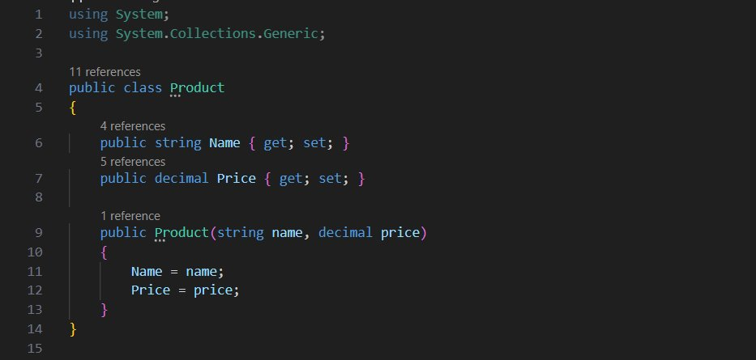
Product Class
Represents a product with properties Name and Price.

Slide 5
Cart Class
The Cart class can deals with cart operations like (add, remove, view, and checkout).
It uses a list for products but only temporarily.

Slide 6
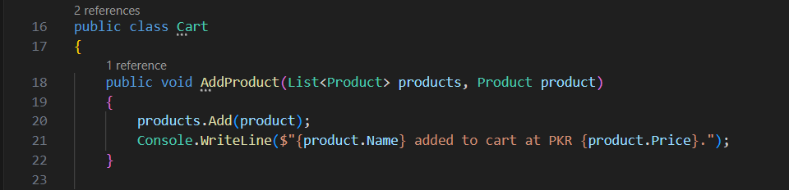
Cart Class – Add Product Function
Adds a new product to the cart.

Slide 7
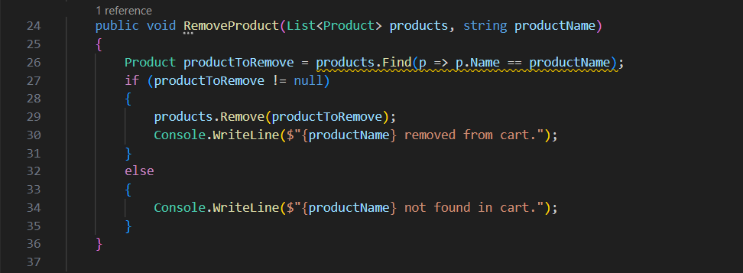
Cart Class – Remove Product Function
Removes a product from the cart by name.

Slide 8
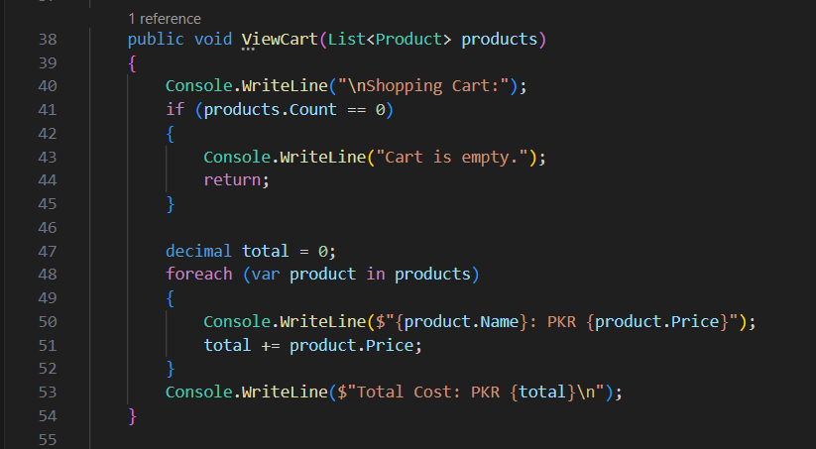
Cart Class – ViewCart Function
Displays all items in the cart with their prices and total cost in PKR.

Slide 9
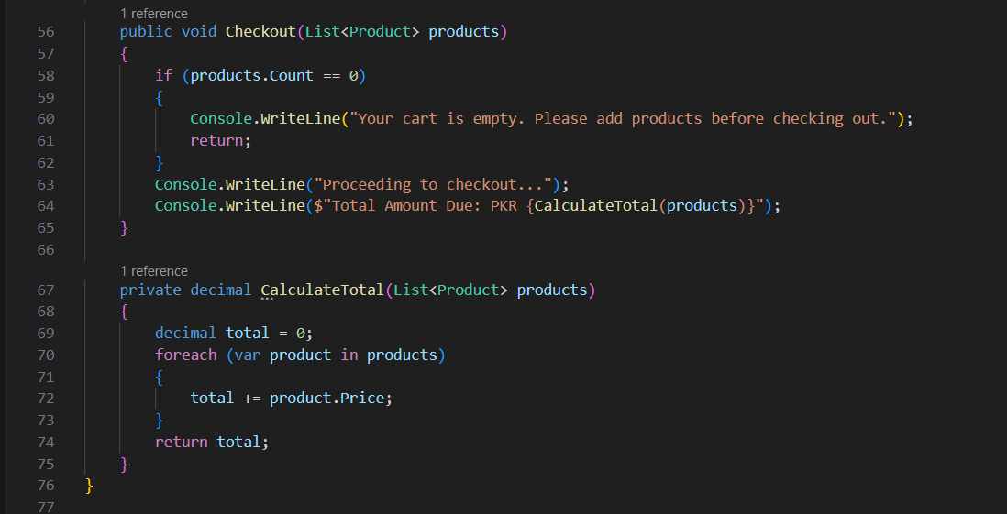
Cart Class – Checkout Function
Finalizes the cart by calculating the total cost if items exist.

Slide 10
Program Class (Main Program)
Provides a user-friendly console menu to interact with the cart.
Displays options for adding, removing, viewing, and checking out products.

Slide 11
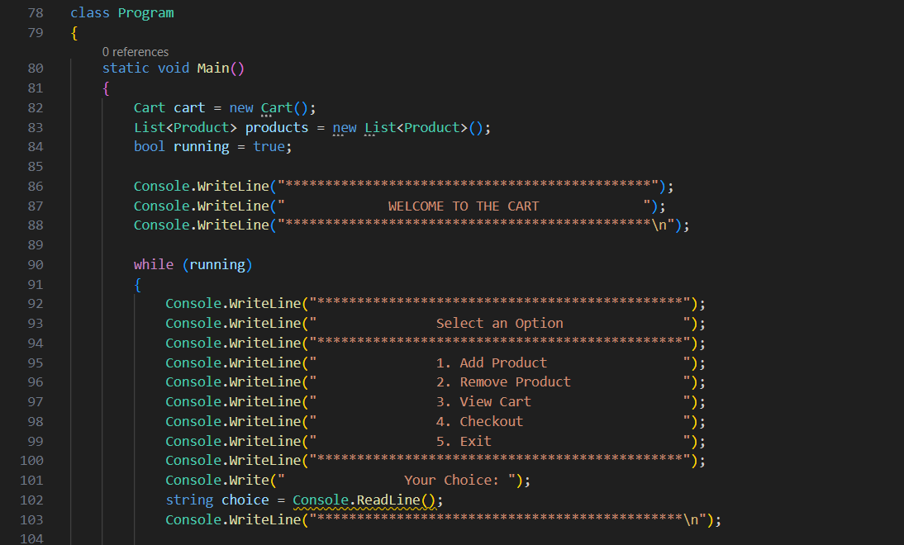
Menu

Slide 12
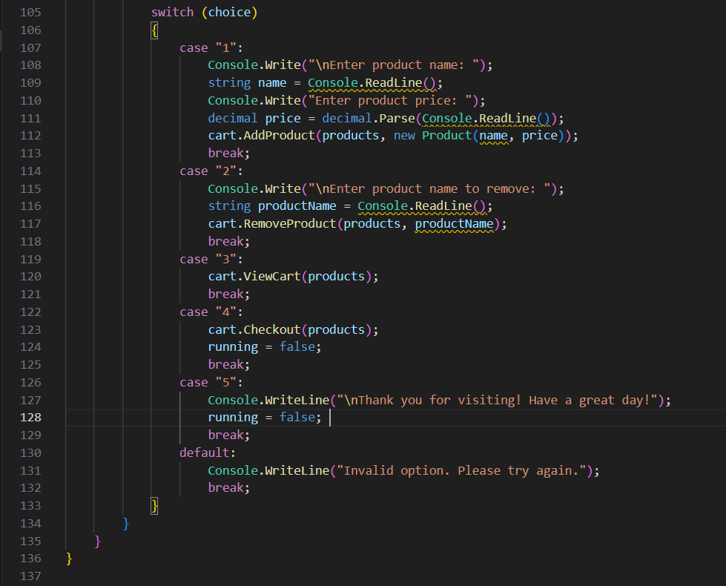
User Choice

Slide 13
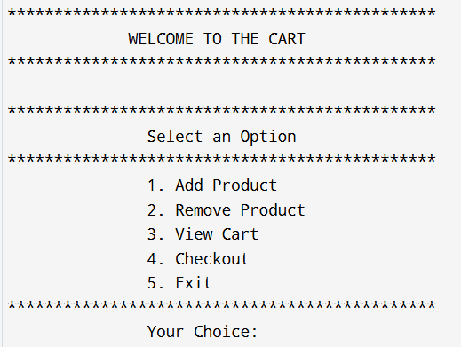
Sample Console Interface

Slide 14

Conclusion
This mini-project effectively demonstrates the basics of object-oriented programming in C#. It provides an interactive shopping cart experience with functionalities like adding, removing, viewing, and checking out items. The project’s modular structure ensures that each component, such as Product and Cart, has clearly defined responsibilities, making the codebase easy to understand and maintain.

